Slide 1

Tunahomba Silaha
655
G

Slide 2
1
Tunaomba silaha tupigane vita
Tunaomba silaha tupigane vita
We plead for the armour of God to fight the enemies.

Slide 3
2
Tunaomba imani ndio ngabo yetu
Tunaomba silaha tupigane vita
We plead for faith to accompany us;
We plead for the armour of God to fight the enemies.

Slide 4
3
Tunaomba maombi ndio nguvu yetu
Tunaomba silaha tupigane vita
Lord, teach us how to pray, it’s our strength.
We plead for the armour of God to fight the enemies.

Slide 5
4
Tunaomba mupanga ndio Neno lako
Tunaomba silaha tupigane vita
We plead for the sword, which is Your Word;
We plead for the armour of God to fight the enemies.

Slide 6
5
Tunaomba silaha tushinde Shetani
Tunaomba silaha tupigane vita
We plead for the armour of God to overcome Satan;
We plead for the armour of God to fight the enemies.

Slide 7
6
Tunaomba, tunaomba;
Tunaomba s i l a h a !
Tunaomba silaha tupigane vita
We do plead and plead !
We plead for the armour of God to fight the enemies.

Slide 8
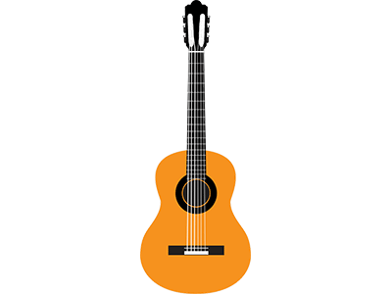
Tutamulaki Yesu

Slide 9
7
Tutamulaki Yesu mawinguni kwa furaha
Tutamulaki Yesu mawinguni kwa furaha
We shall gladly meet with Jesus on the cloud.

Slide 10
8
Baragumu italia na wafu watafufuka!
Tutamulaki Yesu mawinguni kwa furaha
The trumpet shall resound, the dead shall rise to life.

Slide 11
9
Itakuwa furaha tele, kuona uso wa Bwana!
Tutamulaki Yesu mawinguni kwa furaha
What a joy, to see the Lord face to face!

Slide 12
10
Tutafika ’karamu, mawinguni kwa furaha
Tutamulaki Yesu mawinguni kwa furaha
We shall be attending the Wedding Feast with gladness

Slide 13
11
Tutamuona Yesu mawinguni kwa furaha
Tutamulaki Yesu mawinguni kwa furaha
We shall be full of joy at seeing Jesus on the cloud

Slide 14
12
Baragumu italia na wafu watafufuka.
Tutamulaki Yesu mawinguni kwa furaha
We shall be full of joy at seeing Jesus on the cloud

Slide 15
13
Mawinguni, mawinguni;
Mawinguni kwa furaha!
Tutamulaki Yesu mawinguni kwa furaha
We shall gladly meet with Jesus on the cloud.

