Slide 1

Nothing for Jesus
789
[ + solfa ]
C

Slide 2
1
Crowded is your heart with cares,
Have you no room for Jesus?
Captured by earth’ s golden snares,
Have you no room for Jesus?
Lo! He’s standing at your door,
Knocking, knocking o’er and o’er;
Hear Him pleading evermore,
Have you no room for Jesus?

Slide 3
Chorus
Have you no room for Jesus?
Have you no room for Jesus?
Hear Him pleading evermore,
Have you no room for Jesus?

Slide 4
2
Wasting all your precious hours,
Have you no work for Jesus?
Vainly spending all your pow’rs:
Can you not work for Jesus?
Striving not to conquer sin,
Seeking not a soul to win,
Bringing not a wand’rer in;
Can you not work for Jesus?

Slide 5
Chorus
Have you no room for Jesus?
Have you no room for Jesus?
Hear Him pleading evermore,
Have you no room for Jesus?

Slide 6
3
Bearing only worthless leaves,
Have you no fruit for Jesus?
In your hands no precious sheaves,
Have you no fruit for Jesus?
Not a grain to store away,
Naught your labour to repay,
Not a joy for that great day
When you shall meet with Jesus?

Slide 7
Chorus
Have you no room for Jesus?
Have you no room for Jesus?
Hear Him pleading evermore,
Have you no room for Jesus?

Slide 8
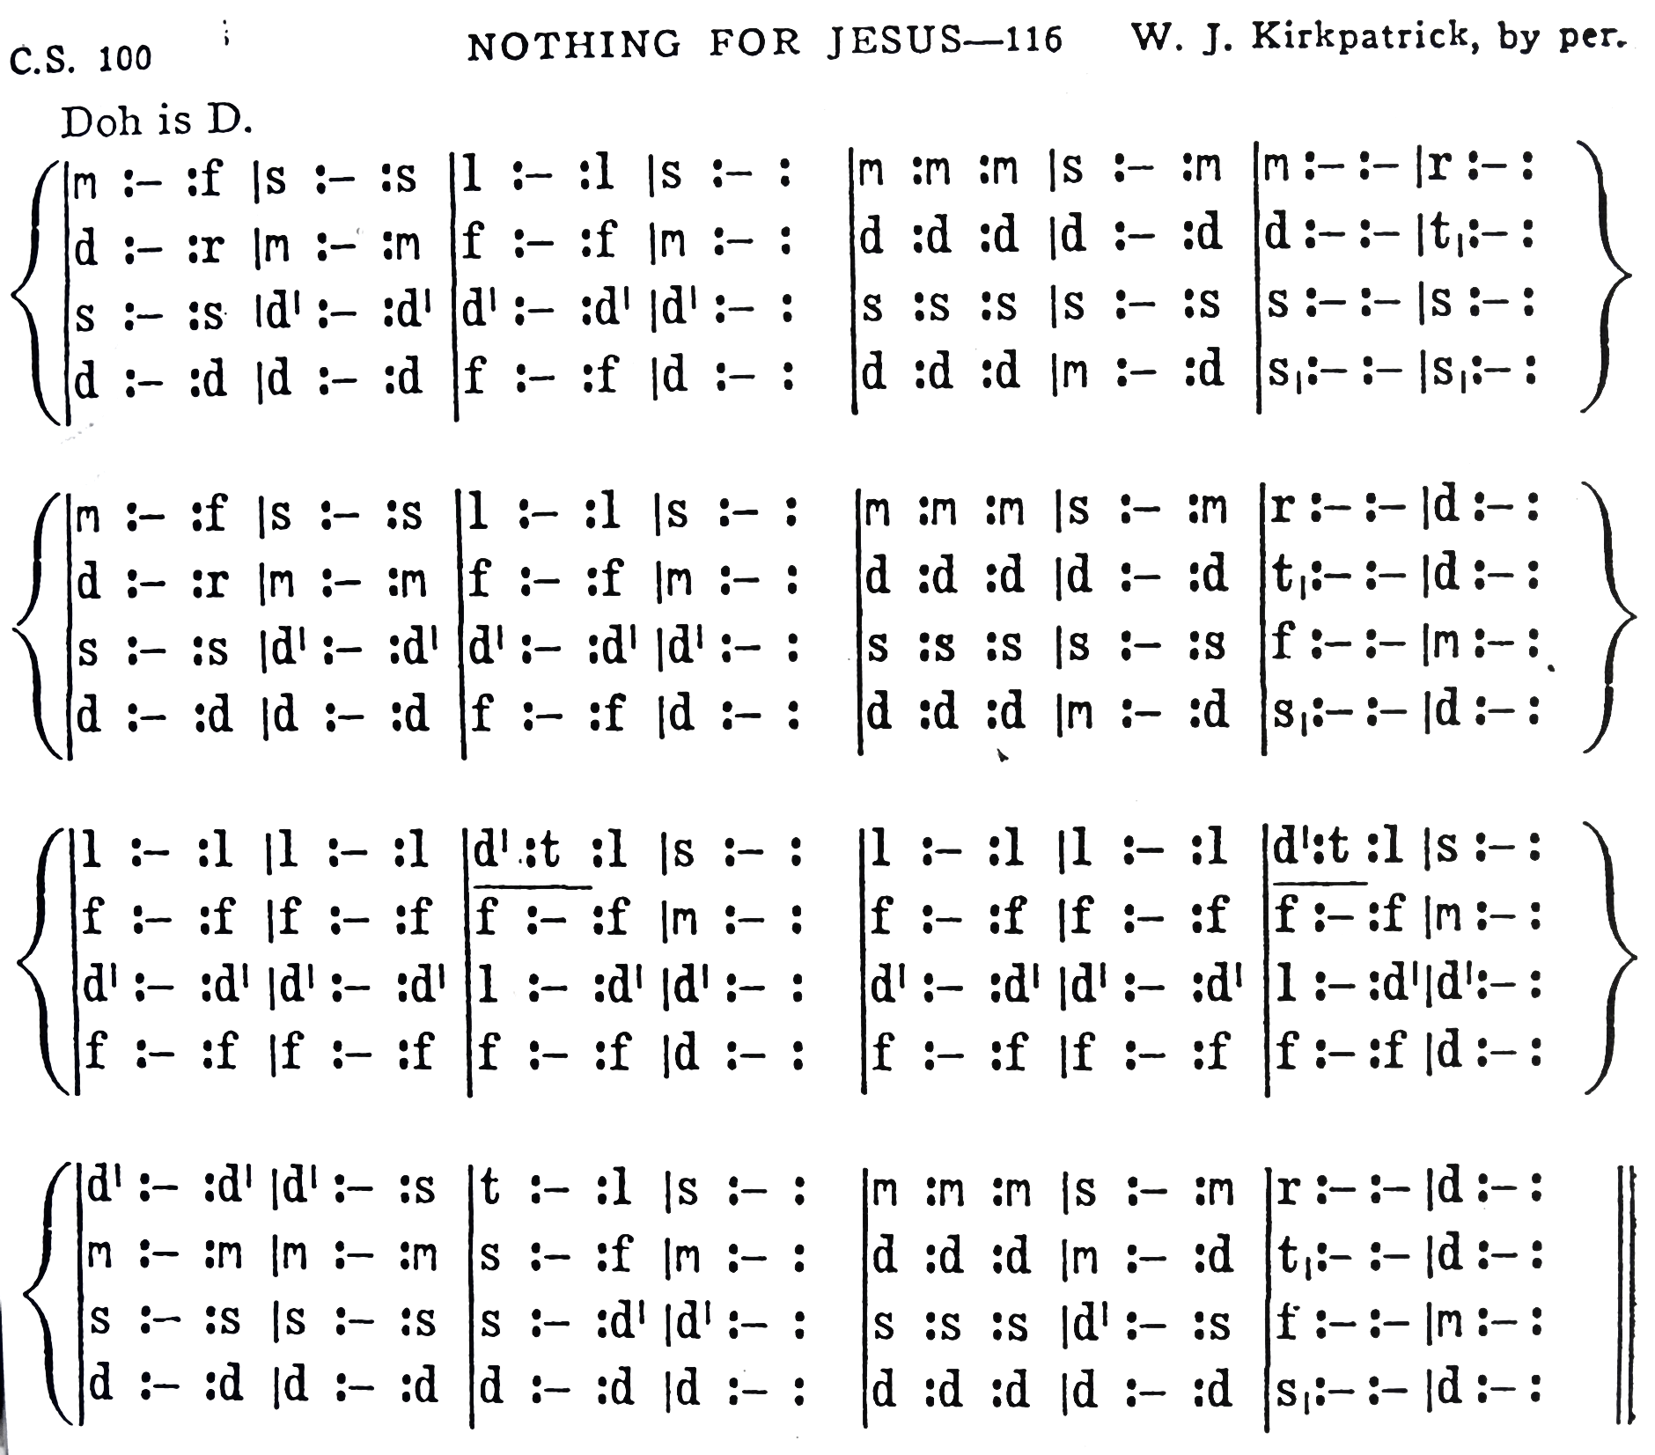
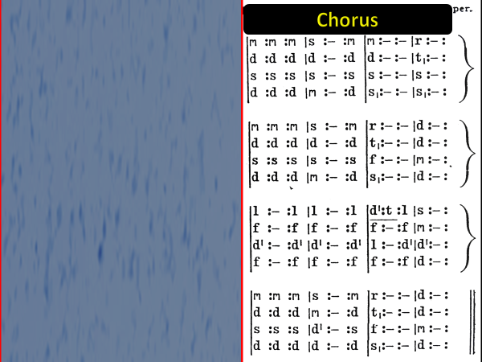
Chorus
Chorus

