Slide 1

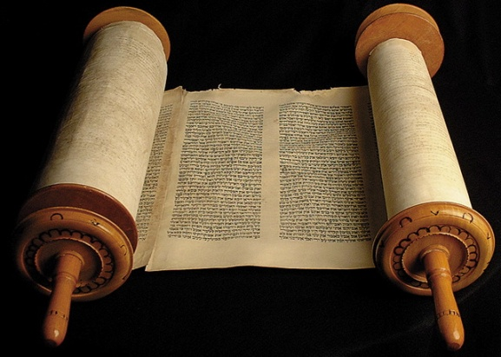

Ancient Words
(Chorus)
369b
X

Slide 2
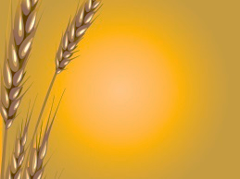
Holy Words, long preserved,
For our walk in this world;
They resound with God’s own heart,
Oh, let the Ancient Words impart.
A n c i e n t Words, ever true,
Changing me and changing you;
We have come with open hearts,
Oh, let the Ancient Words impart.
X2

